Slide 1




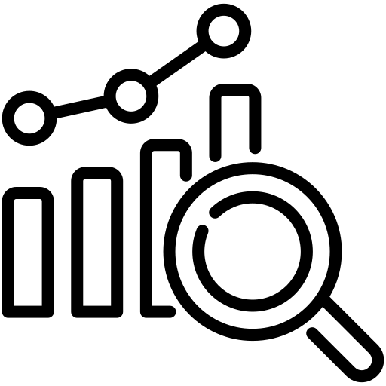

Case Study
How Santos Built a Governed, Scalable & Future-Ready Master Data Foundation with MDO
Overview
Santos, a leading Australian energy company, needed a unified, governed, and automated way to manage millions of engineering and maintenance records across its SAP landscape. MDO enabled them to transform fragmented processes into a standardized, trusted, and scalable master data framework.
Key Challenges
Solution
Approach
The
Results
Conclusion
No global standard for Management of Change (MOC) processes.
No unified taxonomy or ISO 14224 alignment.
700+ monthly BAU data requests, causing delays and manual rework.
High operational effort due to fragmented governance and inconsistent requests.
Alignment of data management processes with engineering MOC standards.
Development of rule-based data quality frameworks for consistency, deduplication, and enrichment.
Automation and prioritization frameworks to reduce manual intervention and optimize cost.
Phased rollout beginning with PNG operations to strengthen governance before global scaling.
Improved SLA adherence and compliance through governed workflows.
Reduced backlog and manual processing via automated load and approval systems.
Lower operational effort with smarter request prioritization.
Higher data trust across Technical Objects, BOMs, Documents, Task Lists, and Maintenance Plans.
Greater visibility into bottlenecks, improving
decision-making and operational reliability.
Santos’ journey with MDO showcases how disciplined governance and automation can transform a complex SAP data landscape into a controlled, reliable, and future-ready data foundation. This shift has positioned Santos to move confidently toward an
AI-enabled, predictive operations strategy.
1

