Slide 1




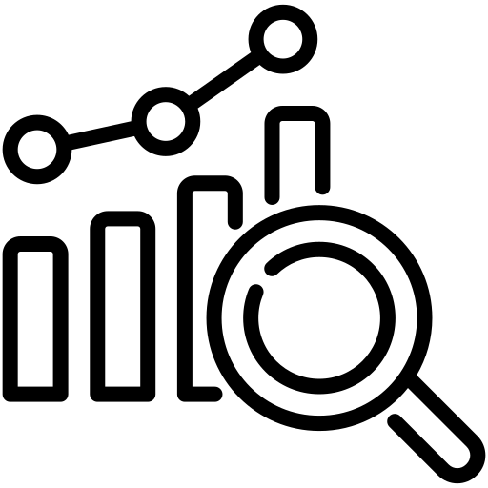

Case Study
How Origin Energy Built a Governed, Scalable & AI-Ready Master Data Foundation with MDO
Overview
Origin Energy, a major energy company focused on energy supply and generation, modernized its fragmented, error-prone asset master data environment by implementing MDO with deep SAP integration. The initiative repositioned asset data as a governed, scalable, and AI-ready foundation for the business, moving from manual workflows to a streamlined, future-focused model.
Key Challenges
Solution
Approach
The
Results
Conclusion
Unreliable Legacy Systems lacking scalability for future transformation.
Manual, Customized, Error-Prone Steps causing rework and poor data quality.
Fragmented Governance with no “Right First Time” control.
Underused SAP–MDO Integration limiting efficiency and automation.
Phased rollout across core asset objects for structured adoption.
Clean reset of legacy CRs for simplified, effective training.
Stakeholder discovery to shape an SAP S/4HANA-aligned process.
Embedded governance with rule-driven, reliable data controls.
AI foundation enabling KAI-based, intent-driven data actions.
Modern, Simplified User Experience aligned with SAP S/4HANA.
Improved Data Quality through built-in rules and standardized capture.
Automated Triage with AI Forms and Rule Engine handling checks, validations, and transformations.
Reliable SAP Updates with governed, synchronous data flow.
Origin Energy proved that modern MDM is a business transformation effort powered by governance, automation, and executive buy-in. With MDO, the organization now operates on a scalable, governed, and AI-enabled master data foundation supporting both current operations and future digital growth.
1

